Slide 1



ML/DL for Everyone with
Lecture 9:
Softmax Classifier
Sung Kim <hunkim+ml@gmail.com> HKUST
Code: https://github.com/hunkim/PyTorchZeroToAll
Slides: http://bit.ly/PyTorchZeroAll
Videos: http://bit.ly/PyTorchVideo

Slide 2

Call for Comments
Please feel free to add comments directly on these slides.
Other slides: http://bit.ly/PyTorchZeroAll
Picture from http://www.tssablog.org/archives/3280

Slide 3
ML/DL for Everyone with
Lecture 9:
Softmax Classifier
Sung Kim <hunkim+ml@gmail.com> HKUST
Code: https://github.com/hunkim/PyTorchZeroToAll
Slides: http://bit.ly/PyTorchZeroAll
Videos: http://bit.ly/PyTorchVideo

Slide 4
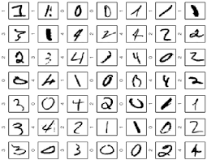
MNIST: 10 labels

Slide 5


10 labels: 10 outputs
Linear
Activation
Linear
Activation
…

Slide 6
10 labels: 10 outputs
Linear
Activation
Linear
?
P(y=0)
P(y=1)
…
…
P(y=9)
Notes:
y \in R^{N\times10}

Slide 7
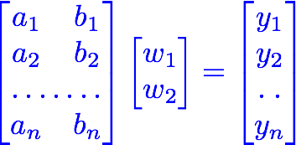
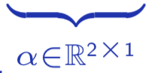

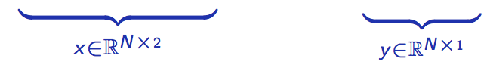
10 outputs
Linear
Activation
Linear
?
P(y=0)
P(y=1)
…
…
P(y=9)
Notes:
y \in R^{N\times10}

Slide 8
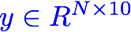
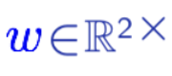
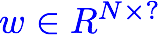

10 outputs
Linear
Activation
Linear
?
P(y=0)
P(y=1)
…
…
P(y=9)
?
Notes:
y \in R^{N\times10}

Slide 9
Probability
Linear
Activation
Linear
?
P(y=0)
P(y=1)
…
…
P(y=9)
Notes:
y \in R^{N\times10}

Slide 10
Softmax
Linear
Activation
Linear
Softmax
P(y=0)
P(y=1)
…
…
…
P(y=9)
Notes:
y \in R^{N\times10}

Slide 11
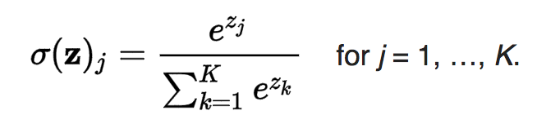

Meet Softmax
Linear
2.0
…
1.0
0.1
Scores (Logits)
Notes:
y \in R^{N\times10}

Slide 12
Meet Softmax
Linear
Softmax
2.0
p (y=0)
0.7
…
1.0
p ( y=1)
0.2
0.1
p (y=2)
0.1
Scores (Logits)
Probabilities
Notes:
y \in R^{N\times10}

Slide 13
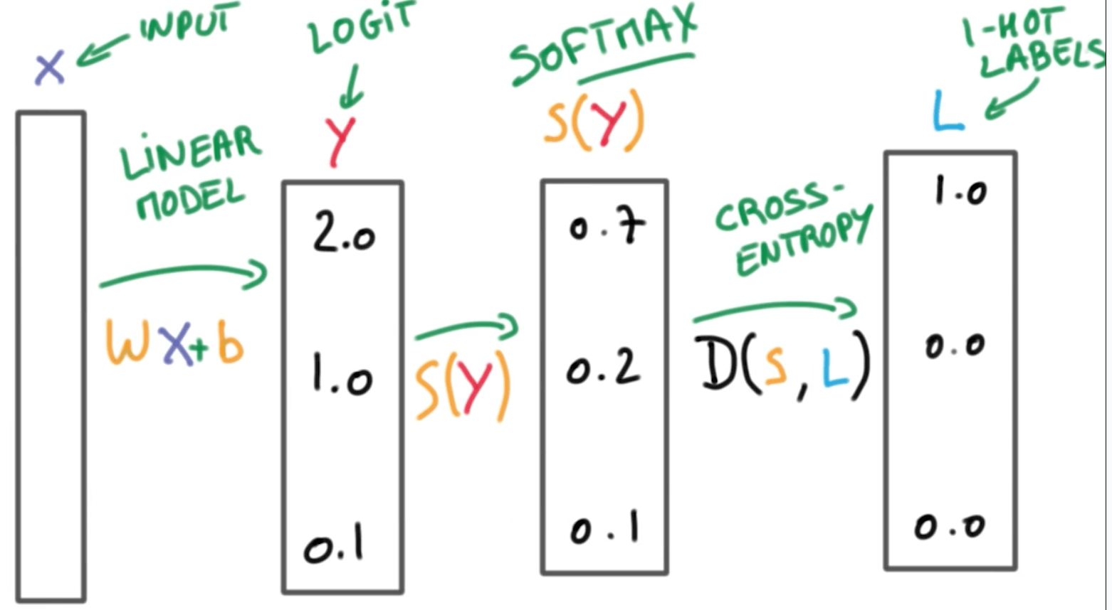

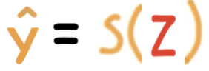
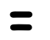


https://www.udacity.com/course/viewer#!/c-ud730/l-6370362152/m-6379811817

Slide 14
https://www.udacity.com/course/viewer#!/c-ud730/l-6370362152/m-6379811817

Slide 15
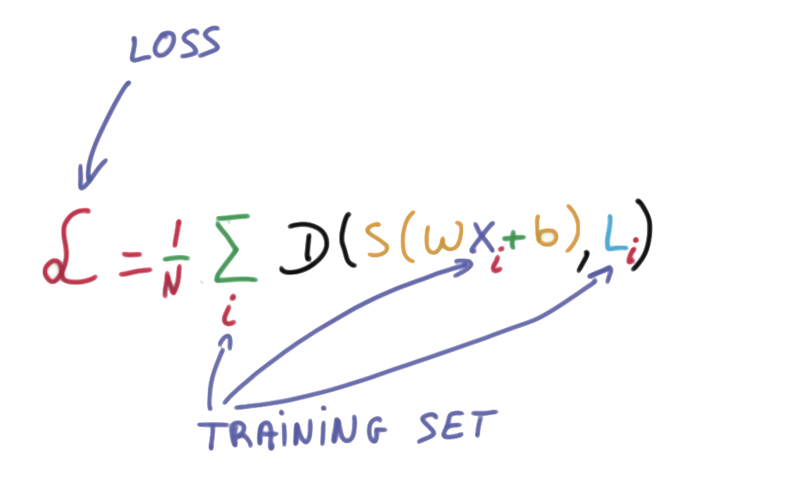
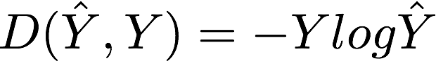
Cost function: cross entropy
https://www.udacity.com/course/viewer#!/c-ud730/l-6370362152/m-6379811817

Slide 16
Cost function: cross entropy
# Cross entropy example
import numpy as np
# One hot
# 0: 1 0 0 0
# 1: 0 1 0 0
# 2: 0 0 1 0
Y = np.array([1, 0, 0])
Y_pred1 = np.array([0.7, 0.2, 0.1])
Y_pred2 = np.array([0.1, 0.3, 0.6])
print("loss1 = ", np.sum(-Y * np.log(Y_pred1)))
print("loss2 = ", np.sum(-Y * np.log(Y_pred2)))
https://www.udacity.com/course/viewer#!/c-ud730/l-6370362152/m-6379811817
Notes:
P(y=i|x) = S(y_{i}) = \frac{e^{y_{i}}}{\sum_{j}e^{y_{j}}} \in (0,1)

Slide 17
Cross entropy in PyTorch
# Softmax + CrossEntropy (logSoftmax + NLLLoss)
loss = nn.CrossEntropyLoss()
# target is of size nBatch
# each element in target has to have 0 <= value < nClasses (0-2)
# Input is class, not one-hot
Y = Variable(torch.LongTensor([0]), requires_grad=False)
# input is of size nBatch x nClasses = 1 x 4
# Y_pred are logits (not softmax)
Y_pred1 = Variable(torch.Tensor([[2.0, 1.0, 0.1]]))
Y_pred2 = Variable(torch.Tensor([[0.5, 2.0, 0.3]]))
l1 = loss(Y_pred1, Y)
l2 = loss(Y_pred2, Y)
print("PyTorch Loss1 = ", l1.data,
"\nPyTorch Loss2=", l2.data)
https://www.udacity.com/course/viewer#!/c-ud730/l-6370362152/m-6379811817
Notes:
P(y=i|x) = S(y_{i}) = \frac{e^{y_{i}}}{\sum_{j}e^{y_{j}}} \in (0,1)

Slide 18
Cross entropy in PyTorch
# Softmax + CrossEntropy (logSoftmax + NLLLoss)
loss = nn.CrossEntropyLoss()
# target is of size nBatch
# element in target has to have 0 <= value < nClasses (0-2)
# Input is class, not one-hot
Y = Variable(torch.LongTensor([2, 0, 1]), requires_grad=False)
# input is of size nBatch x nClasses = 2 x 4
# Y_pred are logits (not softmax)
Y_pred1 = Variable(torch.Tensor([[0.1, 0.2, 0.9],
[1.1, 0.1, 0.2],
[0.2, 2.1, 0.1]]))
Y_pred2 = Variable(torch.Tensor([[0.8, 0.2, 0.3],
[0.2, 0.3, 0.5],
[0.2, 0.2, 0.5]]))
l1 = loss(Y_pred1, Y)
l2 = loss(Y_pred2, Y)
print("Batch Loss1 = ", l1.data, "\nBatch Loss2=", l2.data)
https://www.udacity.com/course/viewer#!/c-ud730/l-6370362152/m-6379811817
Notes:
P(y=i|x) = S(y_{i}) = \frac{e^{y_{i}}}{\sum_{j}e^{y_{j}}} \in (0,1)

Slide 19
Exercise 9-1: CrossEntropyLoss VS NLLLoss
What are the differences?
Check out
http://pytorch.org/docs/master/nn.html#nllloss
http://pytorch.org/docs/master/nn.html#crossentropyloss
Minimizing the Negative Log-Likelihood, in English http://willwolf.io/2017/05/18/minimizing_the_negative_log_likelihood_in_english/

Slide 20
(log)Softmax + NLLLoss
Linear
Activation
Linear
LogSoftmax
P(y=0)
P(y=1)
…
…
P(y=n)
NLLLoss
With NLLLoss

Slide 21

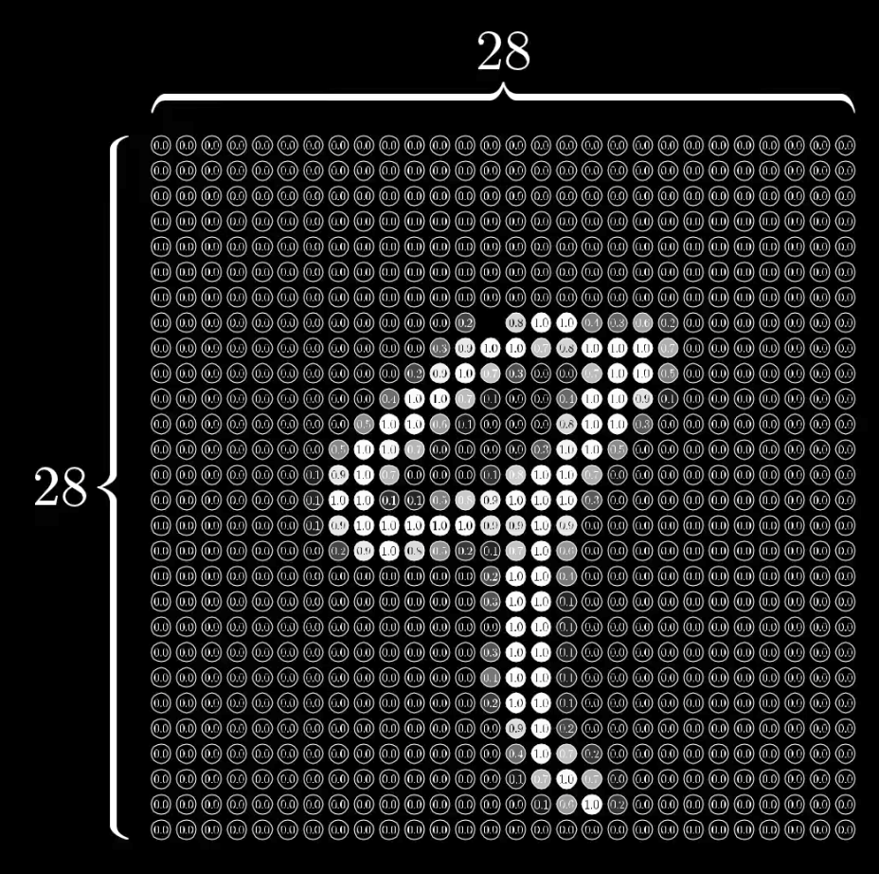
MNIST input
28x28 pixels = 784
https://www.youtube.com/watch?v=aircAruvnKk&t=1s

Slide 22
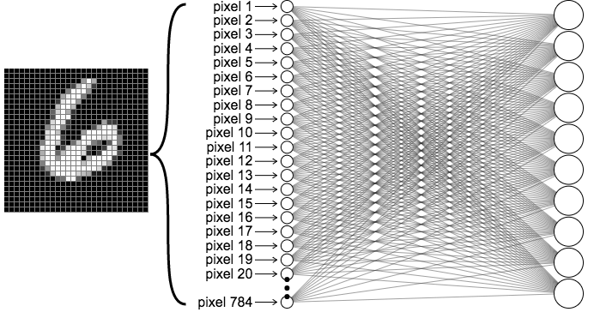



MNIST Network
output layer
10 (labels)
Input layer 784
https://ml4a.github.io/ml4a/looking_inside_neural_nets

Slide 23
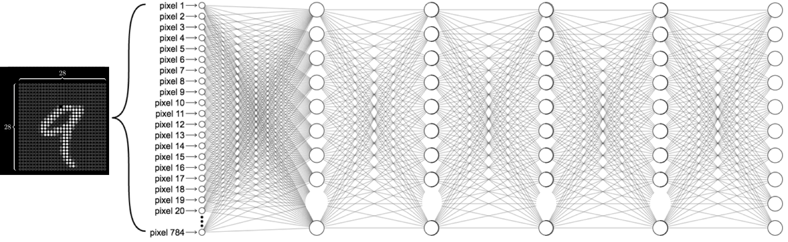
MNIST Network
Input layer 784
Hidden layers
output layer
10 (labels)
https://ml4a.github.io/ml4a/looking_inside_neural_nets

Slide 24
MNIST Network
Input layer 784
hidden 1: 520
hidden 2: 320
hidden 3: 240
hidden 4: 120
output layer
10 (labels)
https://ml4a.github.io/ml4a/looking_inside_neural_nets

Slide 25

MNIST Network
self.l1 = nn.Linear(784, 520)
self.l2 = nn.Linear(520, 320)
self.l3 = nn.Linear(320, 240)
self.l4 = nn.Linear(240, 120)
self.l5 = nn.Linear(120, 10)
https://ml4a.github.io/ml4a/looking_inside_neural_nets

Slide 26
Softmax & NLL loss
class Net(nn.Module):
def __init__(self):
super(Net, self).__init__()
self.l1 = nn.Linear(784, 520)
self.l2 = nn.Linear(520, 320)
self.l3 = nn.Linear(320, 240)
self.l4 = nn.Linear(240, 120)
self.l5 = nn.Linear(120, 10)
def forward(self, x):
# Flatten the data (n, 1, 28, 28)-> (n, 784)
x = x.view(-1, 784)
x = F.relu(self.l1(x))
x = F.relu(self.l2(x))
x = F.relu(self.l3(x))
x = F.relu(self.l4(x))
return self.l5(x) # No need activation
Input layer 784
hidden 1: 520
hidden 2: 320
hidden 3: 240
hidden 3: 120
output layer
10 (labels)
Notes:
\hat{y}=x*w+b
loss = \frac{1}{N}\sum_{n=1}^{N} y^{(n)} \log \hat{y}^{(n)} + (1 - y^{(n)}) \log (1-\hat{y}^{(n})

Slide 27
Softmax & NLL loss
class Net(nn.Module):
def __init__(self):
super(Net, self).__init__()
self.l1 = nn.Linear(784, 520)
self.l2 = nn.Linear(520, 320)
self.l3 = nn.Linear(320, 240)
self.l4 = nn.Linear(240, 120)
self.l5 = nn.Linear(120, 10)
def forward(self, x):
# Flatten the data (n, 1, 28, 28)-> (n, 784)
x = x.view(-1, 784)
x = F.relu(self.l1(x))
x = F.relu(self.l2(x))
x = F.relu(self.l3(x))
x = F.relu(self.l4(x))
return self.l5(x) # No need activation
criterion = nn.CrossEntropyLoss()
…
for batch_idx, (data, target) in enumerate(train_loader):
data, target = Variable(data), Variable(target)
optimizer.zero_grad()
output = model(data)
loss = criterion(output, target)
loss.backward()
optimizer.step()
Notes:
\hat{y}=x*w+b
loss = \frac{1}{N}\sum_{n=1}^{N} y^{(n)} \log \hat{y}^{(n)} + (1 - y^{(n)}) \log (1-\hat{y}^{(n})

Slide 28
MNIST Softmax
# Training settings
batch_size = 64
train_loader = torch.utils.data.DataLoader(
datasets.MNIST('../data', train=True, download=True, transform=transforms.Compose([
transforms.ToTensor(), transforms.Normalize((0.1307,), (0.3081,))])),
batch_size=batch_size, shuffle=True)
test_loader = torch.utils.data.DataLoader(
datasets.MNIST('../data', train=False, transform=transforms.Compose([
transforms.ToTensor(),transforms.Normalize((0.1307,), (0.3081,))])),
batch_size=batch_size, shuffle=True)
class Net(nn.Module):
def __init__(self):
super(Net, self).__init__()
self.l1 = nn.Linear(784, 520)
self.l2 = nn.Linear(520, 320)
self.l3 = nn.Linear(320, 240)
self.l4 = nn.Linear(240, 120)
self.l5 = nn.Linear(120, 10)
def forward(self, x):
x = x.view(-1, 784) # Flatten the data (n, 1, 28, 28)-> (n, 784)
x = F.relu(self.l1(x))
x = F.relu(self.l2(x))
x = F.relu(self.l3(x))
x = F.relu(self.l4(x))
return self.l5(x)
model = Net()
criterion = nn.CrossEntropyLoss()
optimizer = optim.SGD(model.parameters(), lr=0.01, momentum=0.5)
def train(epoch):
model.train()
for batch_idx, (data, target) in enumerate(train_loader):
data, target = Variable(data), Variable(target)
optimizer.zero_grad()
output = model(data)
loss = criterion(output, target)
loss.backward()
optimizer.step()
if batch_idx % 10 == 0:
print('Train Epoch: {} [{}/{} ({:.0f}%)]\tLoss: {:.6f}'.format(
epoch, batch_idx * len(data), len(train_loader.dataset),
100. * batch_idx / len(train_loader), loss.data[0]))

Slide 29

Accuracy?
# Training settings
batch_size = 64
train_loader = torch.utils.data.DataLoader(
datasets.MNIST('../data', train=True, download=True, transform=transforms.Compose([
transforms.ToTensor(), transforms.Normalize((0.1307,), (0.3081,))])),
batch_size=batch_size, shuffle=True)
test_loader = torch.utils.data.DataLoader(
datasets.MNIST('../data', train=False, transform=transforms.Compose([
transforms.ToTensor(),transforms.Normalize((0.1307,), (0.3081,))])),
batch_size=batch_size, shuffle=True)
class Net(nn.Module):
def __init__(self):
super(Net, self).__init__()
self.l1 = nn.Linear(784, 520)
self.l2 = nn.Linear(520, 320)
self.l3 = nn.Linear(320, 240)
self.l4 = nn.Linear(240, 120)
self.l5 = nn.Linear(120, 10)
def forward(self, x):
x = x.view(-1, 784) # Flatten the data (n, 1, 28, 28)-> (n, 784)
x = F.relu(self.l1(x))
x = F.relu(self.l2(x))
x = F.relu(self.l3(x))
x = F.relu(self.l4(x))
return self.l5(x)
model = Net()
criterion = nn.CrossEntropyLoss()
optimizer = optim.SGD(model.parameters(), lr=0.01, momentum=0.5)
def train(epoch):
model.train()
for batch_idx, (data, target) in enumerate(train_loader):
data, target = Variable(data), Variable(target)
optimizer.zero_grad()
output = model(data)
loss = criterion(output, target)
loss.backward()
optimizer.step()
if batch_idx % 10 == 0:
print('Train Epoch: {} [{}/{} ({:.0f}%)]\tLoss: {:.6f}'.format(
epoch, batch_idx * len(data), len(train_loader.dataset),
100. * batch_idx / len(train_loader), loss.data[0]))

Slide 30

train_loader = torch.utils.data.DataLoader(
datasets.MNIST('../data', train=True, download=True, transform=transforms.Compose([
transforms.ToTensor(),
transforms.Normalize((0.1307,), (0.3081,))
])),
batch_size=batch_size, shuffle=True)
test_loader = torch.utils.data.DataLoader(
datasets.MNIST('../data', train=False, transform=transforms.Compose([
transforms.ToTensor(),
transforms.Normalize((0.1307,), (0.3081,))
])),
batch_size=batch_size, shuffle=True)
def train(epoch):
...
def test():
model.eval()
test_loss = 0
correct = 0
for data, target in test_loader:
data, target = Variable(data, volatile=True), Variable(target)
output = model(data)
# sum up batch loss
test_loss += criterion(output, target, size_average=False).data[0]
# get the index of the max log-probability
pred = torch.max(output.data, 1)[1]
correct += pred.eq(target.data.view_as(pred)).cpu().sum()
test_loss /= len(test_loader.dataset)
print('\nTest set: Average loss: {:.4f}, Accuracy: {}/{} ({:.0f}%)\n'.format(
test_loss, correct, len(test_loader.dataset),
100. * correct / len(test_loader.dataset)))

Slide 31
train_loader = torch.utils.data.DataLoader(
datasets.MNIST('../data', train=True, download=True, transform=transforms.Compose([
transforms.ToTensor(),
transforms.Normalize((0.1307,), (0.3081,))
])),
batch_size=batch_size, shuffle=True)
test_loader = torch.utils.data.DataLoader(
datasets.MNIST('../data', train=False, transform=transforms.Compose([
transforms.ToTensor(),
transforms.Normalize((0.1307,), (0.3081,))
])),
batch_size=batch_size, shuffle=True)
def train(epoch):
...
def test():
model.eval()
test_loss = 0
correct = 0
for data, target in test_loader:
data, target = Variable(data, volatile=True), Variable(target)
output = model(data)
# sum up batch loss
test_loss += criterion(output, target, size_average=False).data[0]
# get the index of the max log-probability
pred = torch.max(output.data, 1)[1]
correct += pred.eq(target.data.view_as(pred)).cpu().sum()
test_loss /= len(test_loader.dataset)
print('\nTest set: Average loss: {:.4f}, Accuracy: {}/{} ({:.0f}%)\n'.format(
test_loss, correct, len(test_loader.dataset),
100. * correct / len(test_loader.dataset)))
Y_pred_scores = Variable(
torch.Tensor([[0.3, 0.2, 0.9, 0.1]]))
# torch.max returns both the max values and indices
Y_pred_val, Y_pred_idx =
torch.max(Y_pred_scores.data,1)
Y_pred_idx = torch.max(Y_pred_scores.data,1)[1]

Slide 32
Accuracy?
def train(epoch):
model.train()
for batch_idx, (data, target) in enumerate(train_loader):
data, target = Variable(data), Variable(target)
optimizer.zero_grad()
output = model(data)
loss = criterion(output, target)
loss.backward()
optimizer.step()
if batch_idx % 10 == 0:
print('Train Epoch: {} [{}/{} ({:.0f}%)]\tLoss: {:.6f}'.format(
epoch, batch_idx * len(data), len(train_loader.dataset),
100. * batch_idx / len(train_loader), loss.data[0]))
def test():
model.eval()
test_loss = 0
correct = 0
for data, target in test_loader:
data, target = Variable(data, volatile=True), Variable(target)
output = model(data)
# sum up batch loss
test_loss += criterion(output, target, size_average=False).data[0]
# get the index of the max log-probability
pred = output.data.max(1, keepdim=True)[1]
correct += pred.eq(target.data.view_as(pred)).cpu().sum()
test_loss /= len(test_loader.dataset)
print('\nTest set: Average loss: {:.4f}, Accuracy: {}/{} ({:.0f}%)\n’.
format(test_loss, correct, len(test_loader.dataset),
100. * correct / len(test_loader.dataset)))
for epoch in range(1, 10):
train(epoch)
test()
Train Epoch: 1 [0/60000 (0%)] Loss: 2.313209
Train Epoch: 1 [640/60000 (1%)] Loss: 2.303560
Train Epoch: 1 [1280/60000 (2%)] Loss: 2.296464
Train Epoch: 1 [1920/60000 (3%)] Loss: 2.297758
Train Epoch: 1 [2560/60000 (4%)] Loss: 2.308579
Train Epoch: 1 [3200/60000 (5%)] Loss: 2.300100
Train Epoch: 1 [3840/60000 (6%)] Loss: 2.300800
Train Epoch: 1 [4480/60000 (7%)] Loss: 2.301295
Train Epoch: 1 [5120/60000 (9%)] Loss: 2.295039
...
Train Epoch: 9 [51200/60000 (85%)] Loss: 0.069267
Train Epoch: 9 [51840/60000 (86%)] Loss: 0.044378
Train Epoch: 9 [52480/60000 (87%)] Loss: 0.163481
Train Epoch: 9 [53120/60000 (88%)] Loss: 0.243676
Train Epoch: 9 [53760/60000 (90%)] Loss: 0.045024
Train Epoch: 9 [54400/60000 (91%)] Loss: 0.064958
Train Epoch: 9 [55040/60000 (92%)] Loss: 0.071447
Train Epoch: 9 [55680/60000 (93%)] Loss: 0.043712
Train Epoch: 9 [56320/60000 (94%)] Loss: 0.099484
Train Epoch: 9 [56960/60000 (95%)] Loss: 0.159727
Train Epoch: 9 [57600/60000 (96%)] Loss: 0.109291
Train Epoch: 9 [58240/60000 (97%)] Loss: 0.116370
Train Epoch: 9 [58880/60000 (98%)] Loss: 0.127303
Train Epoch: 9 [59520/60000 (99%)] Loss: 0.030254
Test set: Average loss: -12.1596, Accuracy: 9697/10000 (97%)

Slide 33
Multiple label prediction?
Just use CrossEntropyLoss!
Linear
Activation
Linear
…
…
CrossEntropyLoss
With CrossEntropyLoss

Slide 34
Exercise 9-2
Build a classifier for Otto Group Product
https://www.kaggle.com/c/otto-group-product-classification-challenge/data
Use train.csv.zip (1.59 MB)
Use DataLoader

Slide 35


Lecture 10: CNN

